Slide 1
Sveep Nodel Officer:Dr. Meena Maan
{Voter Awareness Program}
District :Durg

Slide 2
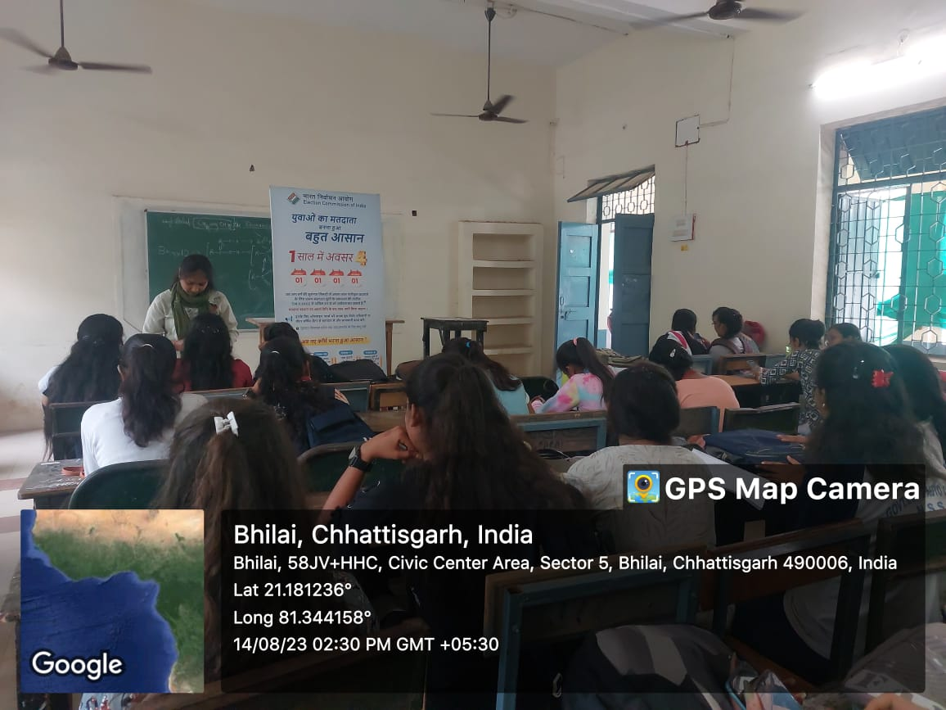
Voter helpline app was downloaded

Slide 3
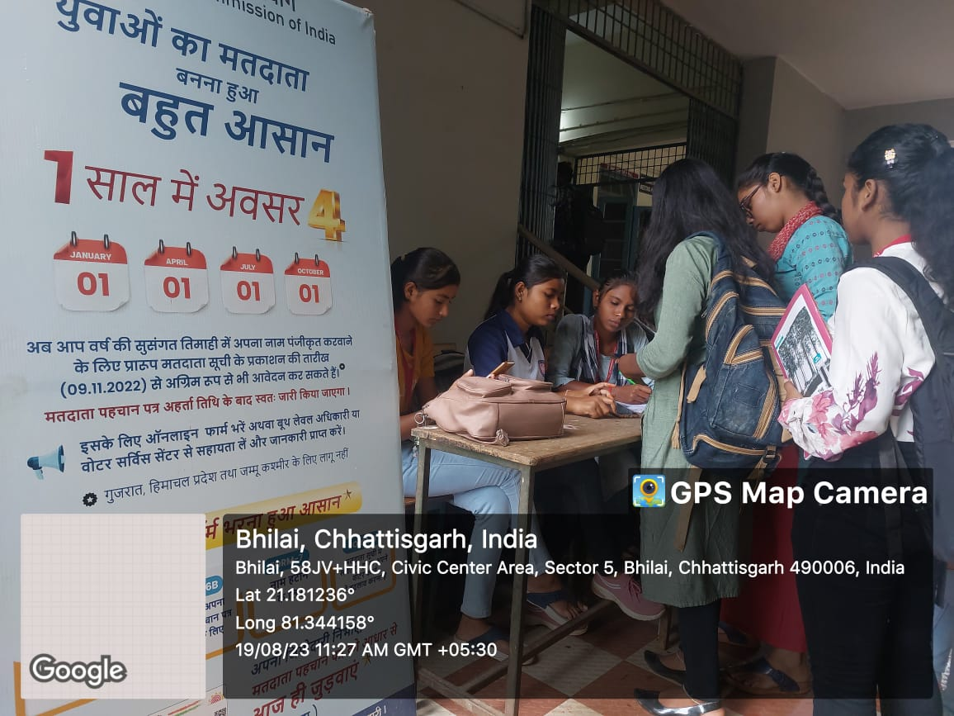
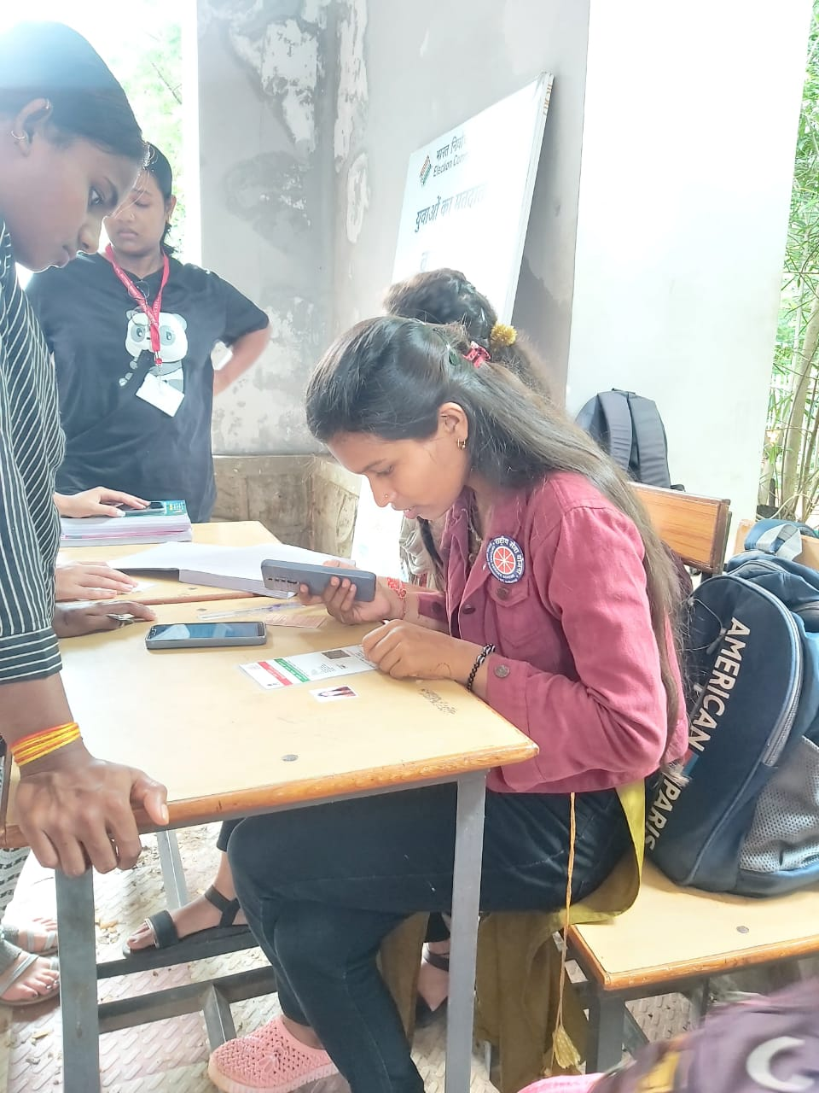
New voter id created more than 750 students at science college durg

Slide 4
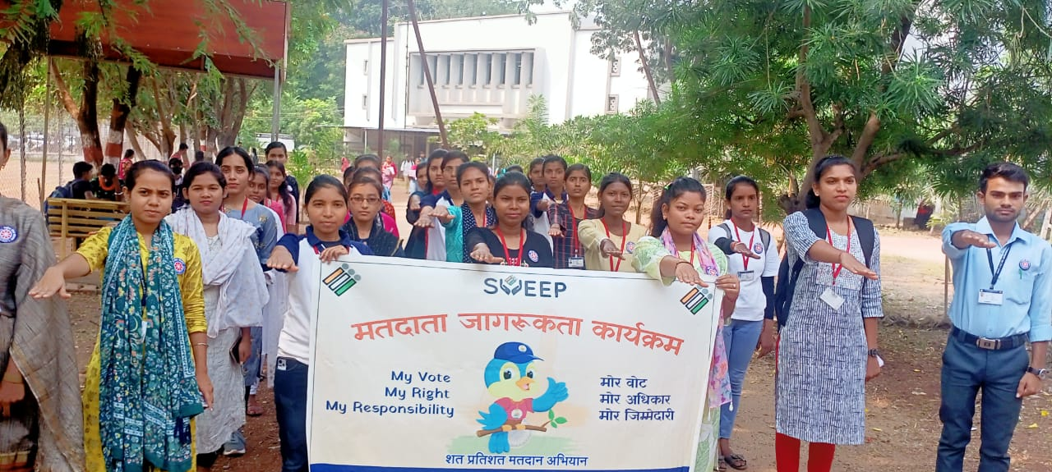
Youth pledge to vote

Slide 5
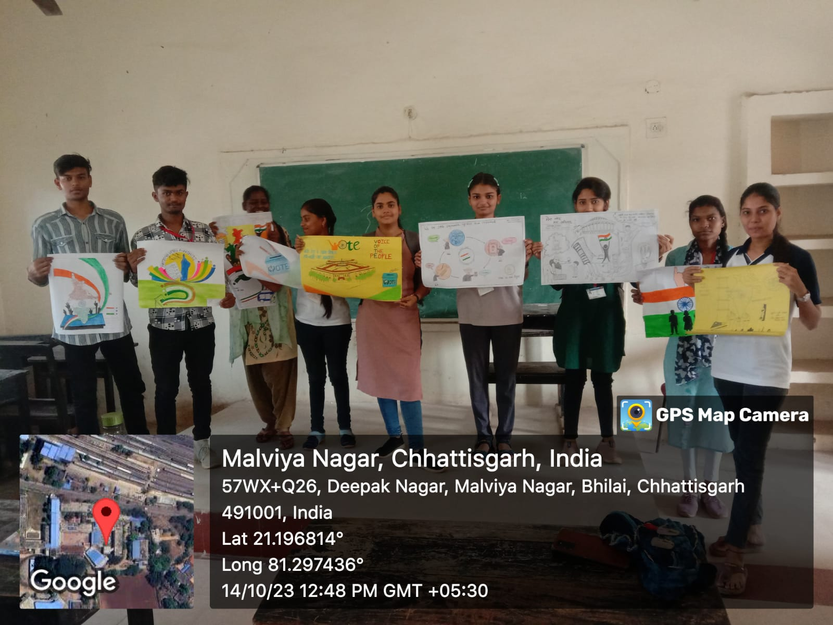
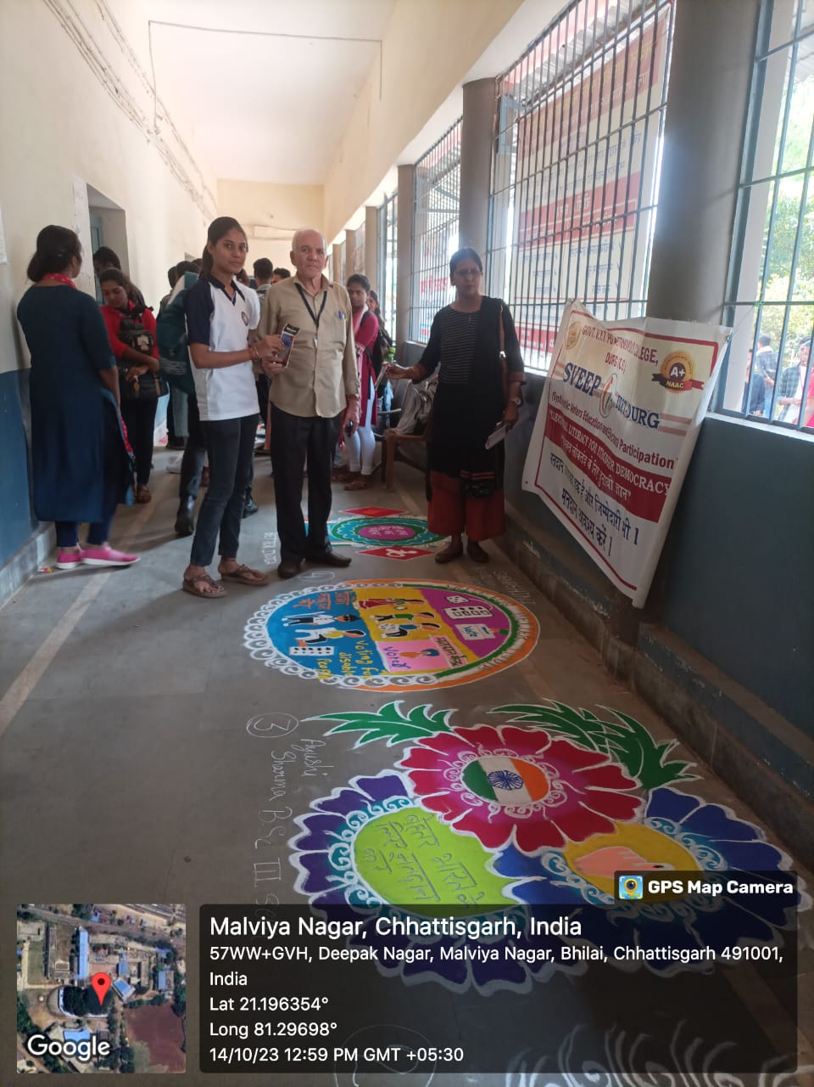
Painting competition
Rangoli competition

Slide 6
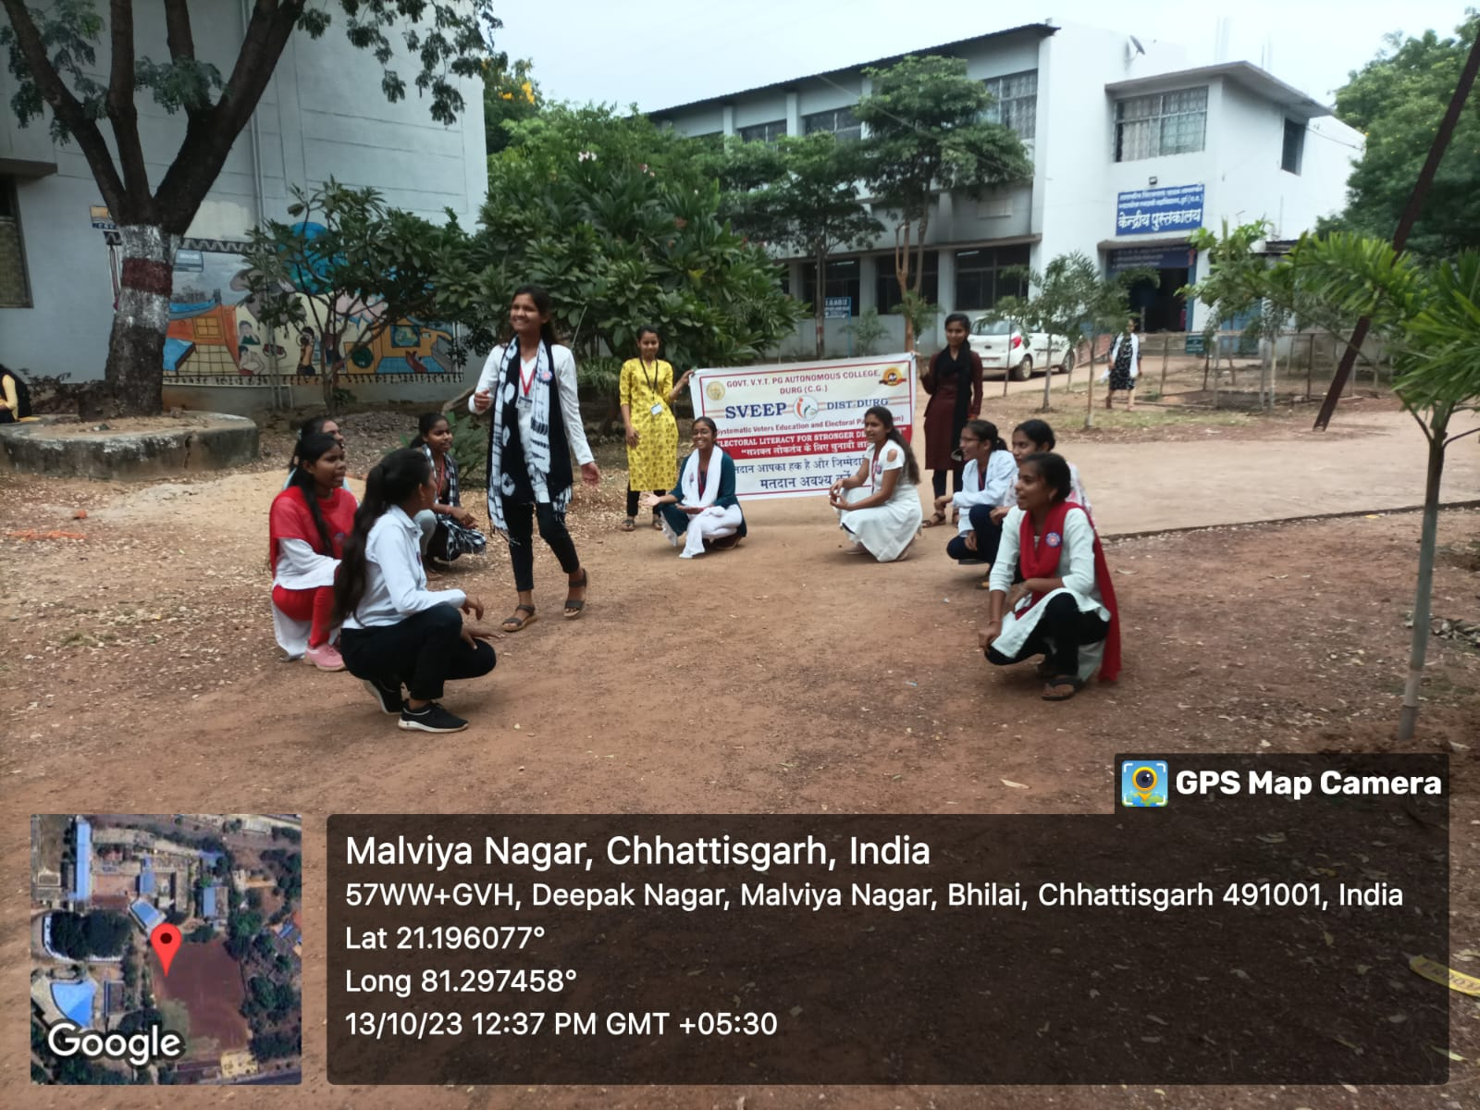
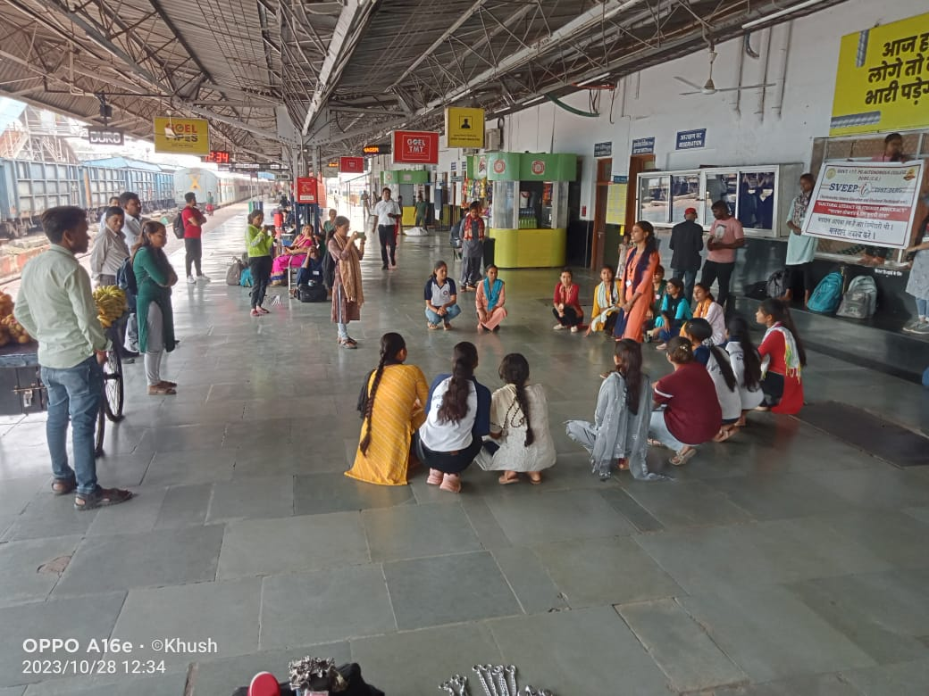
Nukkad natak for voter awarness
At college campus
At railway station durg

Slide 7
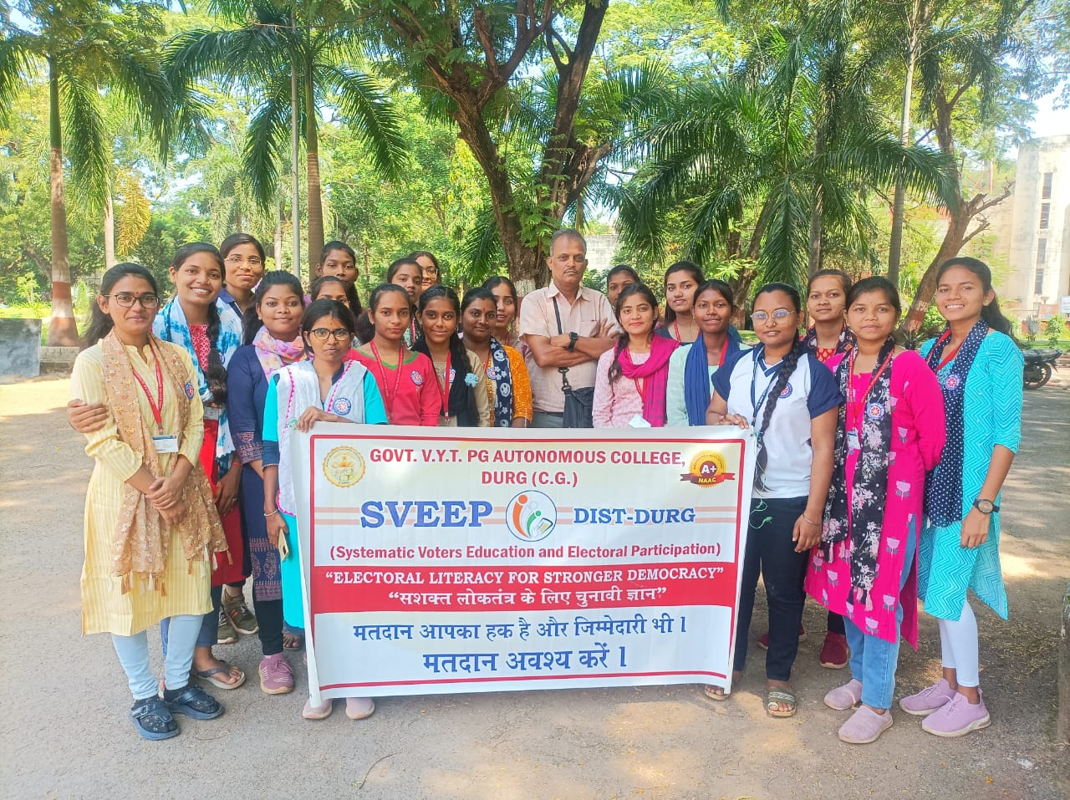
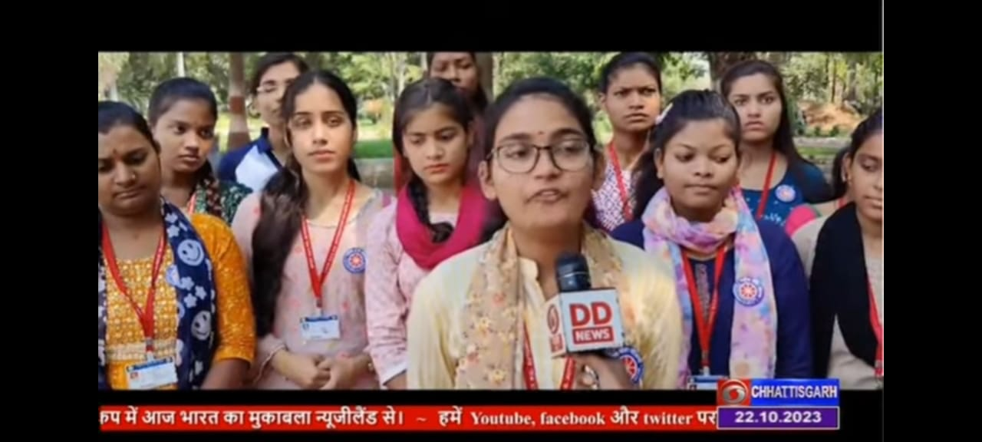
Student who voted for the first time were interviewed by DD news

Slide 8
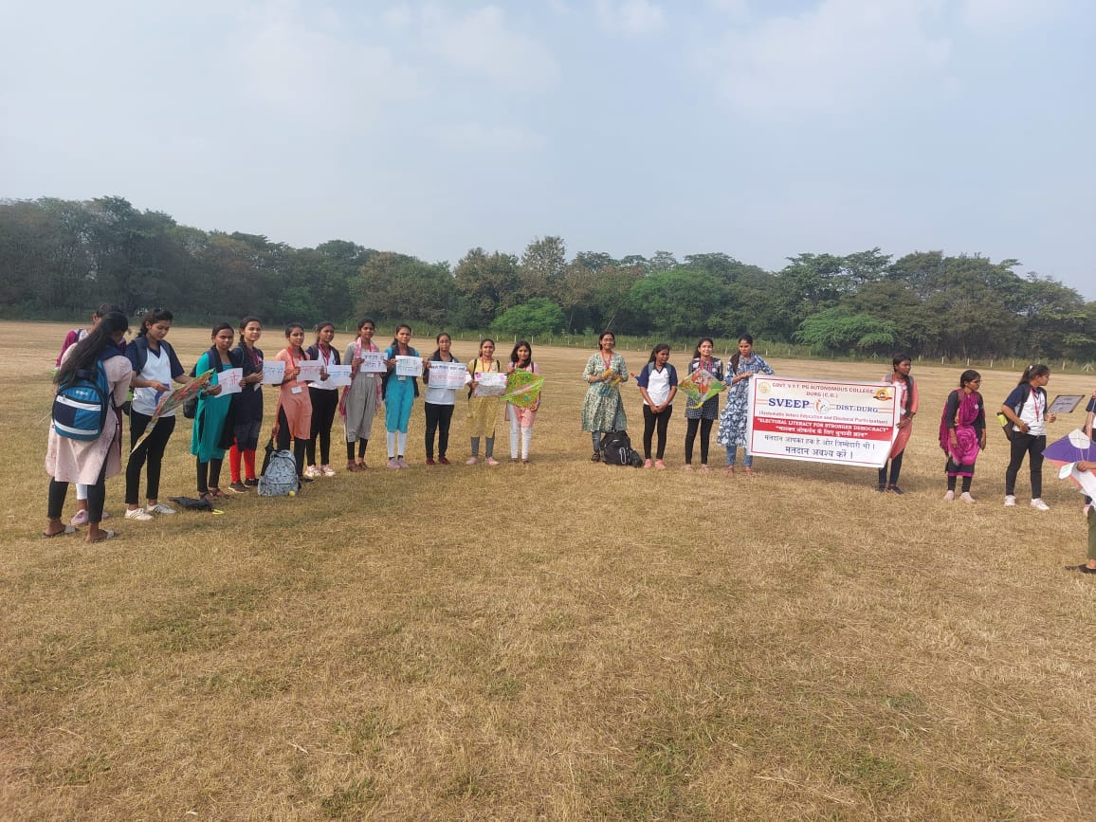
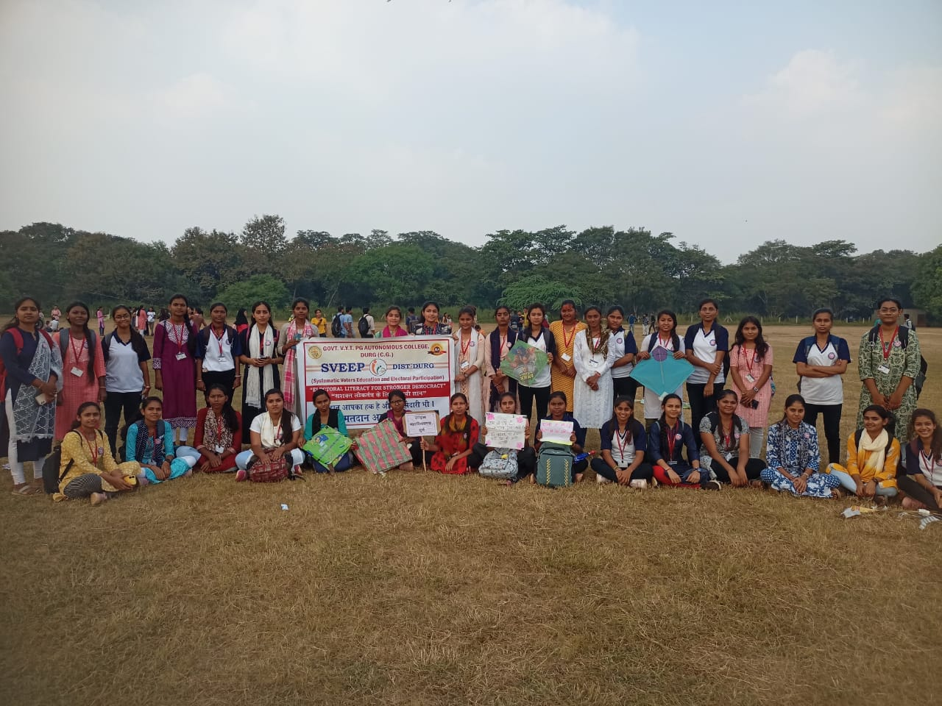
Kite festival at “Jayanti stadium” for voter awareness

Slide 9
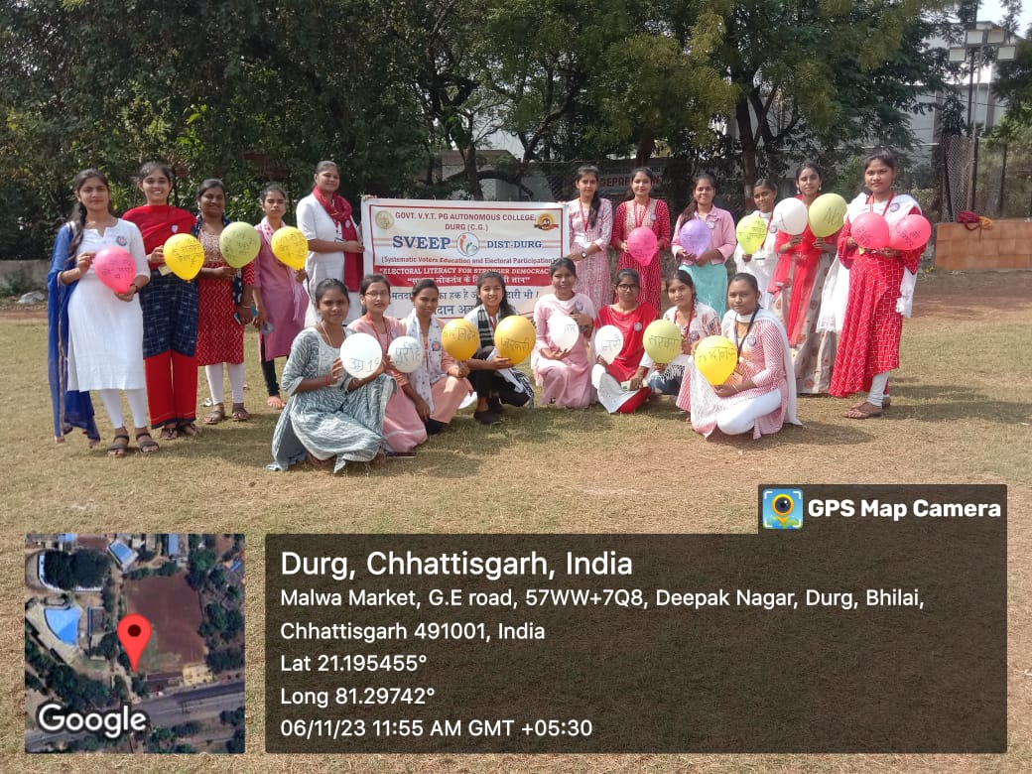
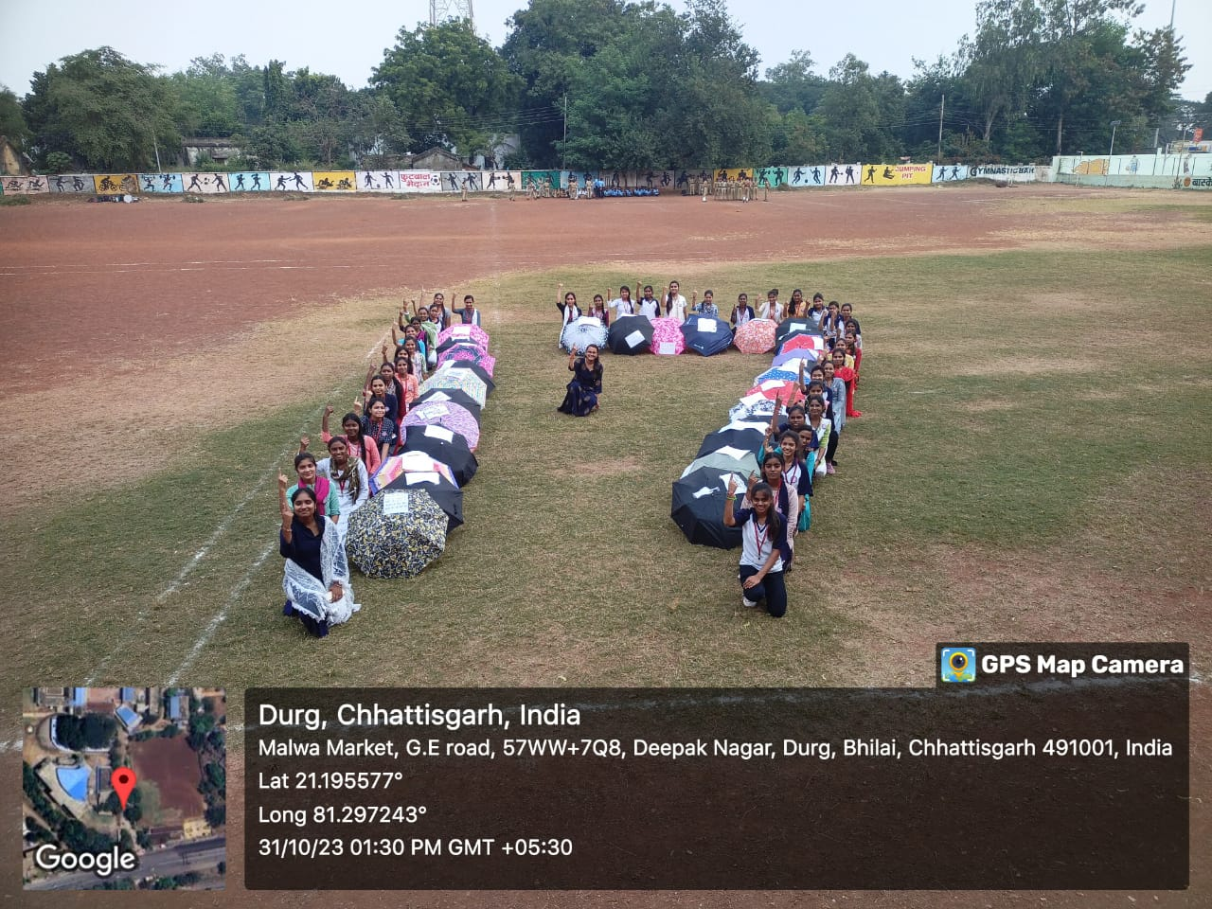
Umbrella festival at college
campus for voter aawreness
Voter awareness program by balloon

Slide 10
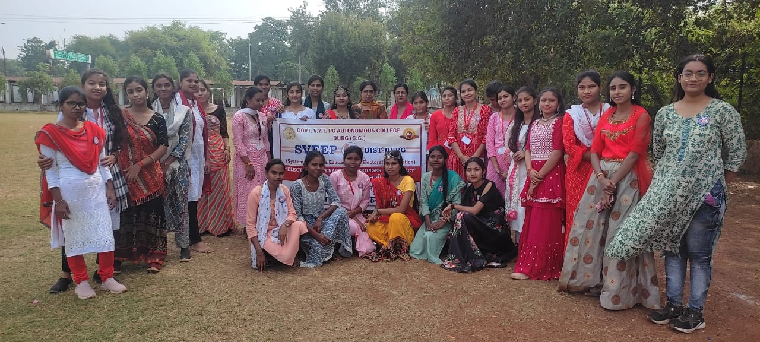
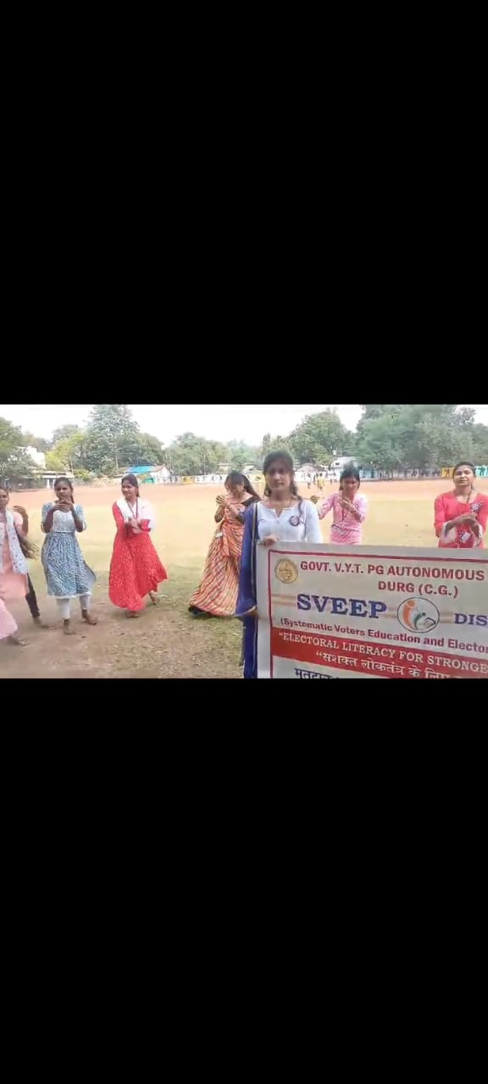
Sveep garba at college campus

Slide 11
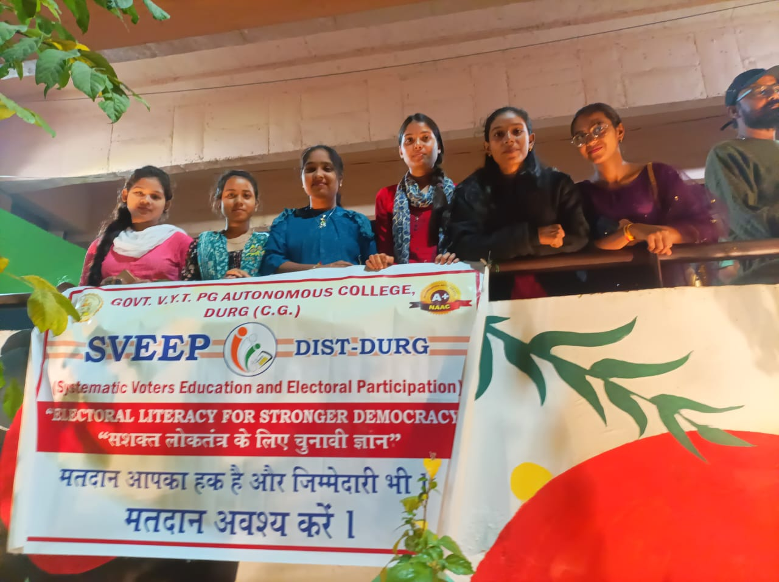
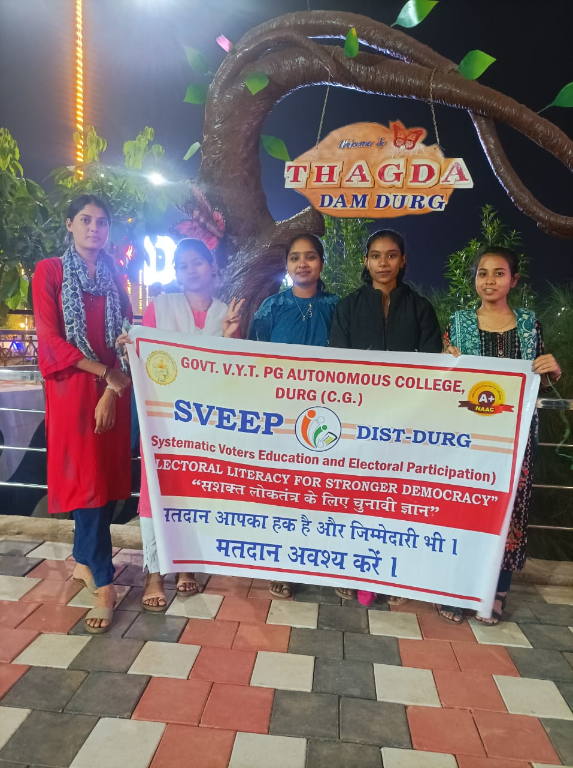
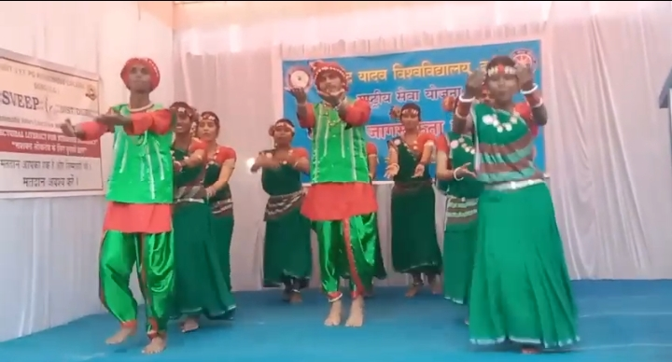
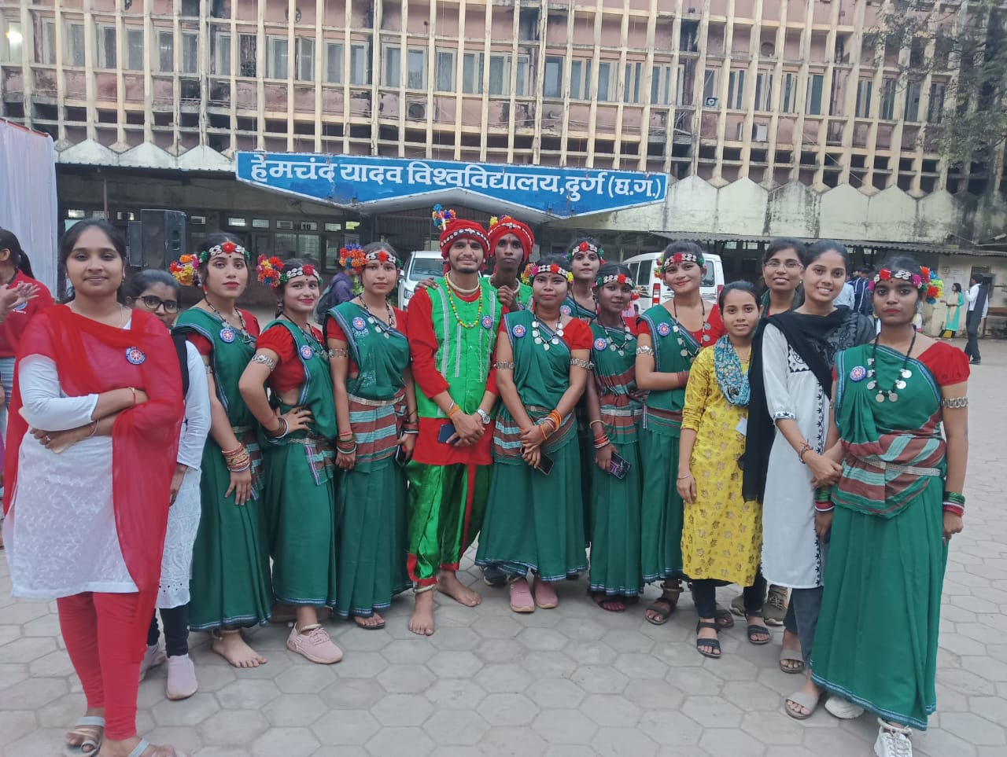
Student arrived to watch the performance of battel of band at “Thagda dam”
Dance performed by the student of our college in” hemchand university” for voter awareness

